Slide 1
Python docstring and modules

Slide 2
What is a Docstring ?
Python documentation strings(or docstrings) provide a convenient way of associating documentation with Python modules, functions, classes and methods.
An object’s docstring is defined by including a string constant as the first statement in the object’s definition.
It’s specified in source code that is used, like a comment, to document a specific segement of code.
Unlike conventional source code comments the docstring should describe what the function does, not how.
All functions should have a docstring.This allows the program to inspect these comments at run time, for instance as an interactive help system, or as metadata.
Docstrings can be accessed by the __doc__ attribute of an objects.

Slide 3
How should a Docstring look like?
The doc string line should begin with a capital letter and end with a period.
The first line should be a short description.
Don’t write the name of the object.
If there are more lines in the documentation string, the second line should be blank, visually separating the summary from the rest of the description.
The following lines should be one or more paragraphs describing the object’s calling conventions, it sides effects, etc.

Slide 4
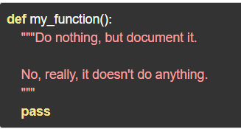
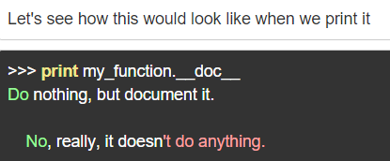
Docstring Example :

Slide 5
There are two forms of docstring:
One-line Docstrings: One liners are for really obvious cases. They should really fit on one line. For example :
Notes: Triple quotes are used even though the string fits on one line. This makes it easy to later expand it.
The closing quotes are on the same line as the opening quotes. This look better for one liners.
There’s no blank line either before or after the docstring.

Slide 6

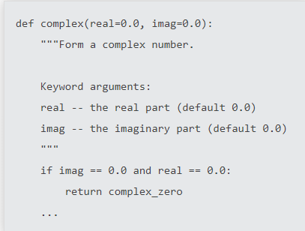
Example :
Multi-line Docstrings:- Multi-line docstrings consist of a summary line just like a one-line docstring, followed by a blank line, followed by a more elaborate description

Slide 7
Modules:
If you quit from the Python interpreter and enter it again, the definitions you have made (functions and variables) are lost. Therefore, if you want to write a somewhat longer program, you are better off using a text editor to prepare the input for the interpreter and running it with that file as input instead. This is known as creating a script. As your program gets longer, you may want to split it into several files for easier maintenance. You may also want to use a handy function that you’ve written in several programs without copying its definition into each program.
To support this, Python has a way to put definitions in a file and use them in a script or in an interactive instance of the interpreter. Such a file is called a module; definitions from a module can be imported into other modules or into the main module (the collection of variables that you have access to in a script executed at the top level and in calculator mode).

Slide 8
Modules….
A module is a file containing Python definitions and statements. The file name is the module name with the suffix .py appended.
A module can contain executable statements as well as function definition. These statements are intended to initialize the module. They are executed only the first time the module name is encountered in an import statement.
Modules can import other modules. It is customary but not required to place all import statements at the beginning of a module.
Import math → to import math module
It will all the functions except those beginning with a underscore( _ )

Slide 9
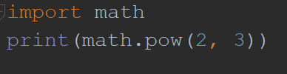
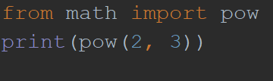
Modules….
from…..import → by using this we can import particular functions.
from ….. Import * -→by using this we can import all the functions
If we use from……import ……. Then it is not necessary to use module name before calling the function

Slide 10
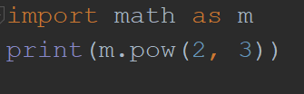
Modules…
Note that in general the practise of importing * from a module or package is frowned upon, since it often causes poorly readable code. However, it is okay to use it to save typing in interactive sessions.
If the module name is followed by as, then the name following as is bound directly to the imported module.

